Slide 1








AI-powered Smart Lighting & Energy Management for Smart Cities
Internship @ ACUD

Slide 2

Table of contents
System Overview
01
02
Introduction
03
Recommendations
04
Business Plan
05
Conclusion
06
Contact data

Slide 3


Introduction
01

Slide 4
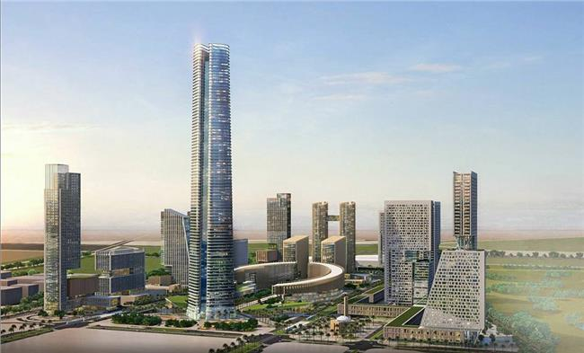
Introduction:-
________
The Administrative Capital for Urban Development (ACUD) is the master developer of Egypt’s New Administrative Capital (NAC). Established to design, build, and manage a world-class smart city. Oversees infrastructure, digital transformation, and sustainable city solutions.
Fig(1) AC

Slide 5
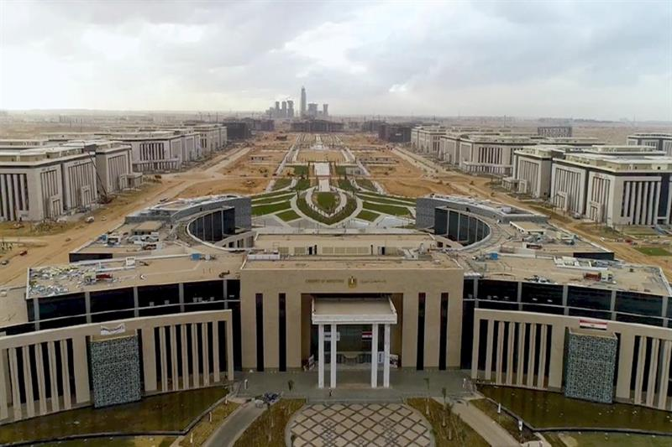


Background information:-
________
ACUD Mission
Build a sustainable, technology-driven capital
Provide smart infrastructure for energy, water, transport, and communication
Position Egypt as a regional leader in smart cities
ACUD Vision
A fully digital, green, and connected city
Improve quality of life through IoT, AI, and big data
Create an international model of smart urban development
Fig (2), UD

Slide 6




Objective
Lighting consumes 20–40% of city electricity
Smart lighting reduces energy use, adapts to weather & occupancy, and cuts CO₂ emissions
Growing electricity demand in cities
Need for energy-efficient solutions
Lighting system is a key entry point for smart infrastructure
Use IoT data to predict energy consumption
Classify weather conditions that impact lighting demand
Develop a machine learning model for energy forecasting
Support ACUD’s sustainability mission
Fig (3), Our project

Slide 7

Idea of the project
Project Idea
Regression Target:
energy_consumption_kwh → Predict energy usage (continuous).
Classification Target:
lighting_action_class → Predict lighting action (discrete classes like dim, brighten, keep constant).
It explores the integration of IoT, sensors, AI, and automation

Slide 8


System Overview
02

Slide 9




Data Collection
This dataset contains data representing an IoT-enabled Smart Lighting System for urban environments for fault detection.
It captures sensor readings, environmental conditions, and lighting control decisions over the course of one year (2024) across multiple city zones.
timestamp
zone_id
ambient_light_lux
motion_detected
temperature_celsius
occupancy_count
day_of_week
time_of_day
weather_condition
special_event_flag
energy_price_per_kwh
prev_hour_energy_usage_kwh
traffic_density
avg_pedestrian_speed
adjusted_light_intensity
energy_consumption_kwh
lighting_action_class

Slide 10
EDA
Exploratory Data Analysis (EDA)
Purpose: Understand the dataset’s characteristics, distributions, and relationships to inform preprocessing and modeling.
Process:
  Shape Analysis: Check the dataset’s dimensions to confirm the number of rows and columns, ensuring sufficient data for modeling.
  Data Types and Structure: Review column data types (numerical: floats/ints; categorical: strings) and memory usage to plan preprocessing (e.g., encoding categoricals).
  Missing Value Check: Verify if any data is missing to assess data quality and determine if imputation or removal is needed (none found here).
  Summary Statistics: Compute descriptive statistics (mean, standard deviation, min, max, quartiles) for numerical features to understand distributions, detect outliers, and identify scaling needs.
  Group-Based Analysis: Aggregate data by categorical variables (e.g., time of day) to compute average energy consumption, revealing patterns like higher usage at night.

Slide 11
Preprocessing Steps
Data Preprocessing
Purpose: Prepare the data for machine learning by transforming it into a suitable format.
Process (inferred from imports):
  Categorical Encoding: Convert categorical variables (e.g., day_of_week, weather_condition, time_of_day) into numerical form using techniques like label encoding to make them compatible with machine learning algorithms.
  Feature Scaling: Standardize numerical features (e.g., ambient_light_lux, temperature_celsius, traffic_density) to have a mean of 0 and standard deviation of 1, ensuring equal weighting in models sensitive to scale.
  Feature Selection: Select relevant features for regression (energy_consumption_kwh as target) and classification (lighting_action_class as target), potentially excluding irrelevant ones like timestamp.
  Train-Test Split: Divide the dataset into training and testing sets (e.g., 80% train, 20% test) to evaluate model performance on unseen data.

Slide 12
Choosing the model🌳
1. Handles Complex Relationships
Smart lighting and energy consumption are influenced by many nonlinear factors (time, weather, traffic, etc.).
Random Forest captures nonlinear interactions between features better than simple models like Linear Regression.
2. Works Well with Mixed Data
Your dataset has numerical (temperature, humidity, hour) and categorical (weather condition, day_of_week) features.
Random Forest can natively handle this mix after encoding.
3. Robust Against Overfitting
Unlike a single decision tree, Random Forest builds many trees and averages them.
This reduces overfitting and gives stable, reliable predictions.

Slide 13
Choosing the model 🌳
4. Feature Importance
It provides feature importance scores, so you can explain:
  How much “weather condition” affects energy use.
  Whether “adjusted_light_intensity” is the biggest driver.
5. High Accuracy
Often outperforms simpler models in practice for regression and classification.
Great for real-world IoT applications where accuracy matters more than model simplicity.
6. Scalability
Works well on medium-to-large datasets.
Can be parallelized, making it efficient for smart city–scale problems.

Slide 14
Model Evaluation
Purpose: Assess the performance of trained models to ensure they generalize well to new data.
Process (inferred from imported metrics):
  Regression Evaluation: Compute metrics like Mean Squared Error (MSE) to measure prediction error and R² Score to assess how well the model explains variance in energy_consumption_kwh.
  Classification Evaluation: Calculate accuracy (fraction of correct predictions), precision, recall, and F1-score (via classification report) to evaluate lighting_action_class predictions. Generate a confusion matrix to analyze true positives, true negatives, false positives, and false negatives.

Slide 15

Summarize
Data Flow
Preprocessing Data
EDA
Clean Data/ Data analysis
Choosing the model
Plotting

Slide 16


Recommendations
03

Slide 17



Recommendations
1. Scaling the System Across ACUD
Start with a pilot project (e.g., one district or a main road).
Gradually expand to cover entire smart lighting infrastructure.
2. Integration with ACUD Smart Systems
Connect lighting control with ACUD’s central command & IoT platform.
Share real-time data with energy management systems and traffic monitoring.

Slide 18
Recommendations
3. Maintenance & Reliability
Implement predictive maintenance for streetlights using IoT sensors.
Use data from the system to predict lamp failures before they happen.
4. KPIs to Track
% reduction in energy consumption.
% reduction in operational costs.

Slide 19


Live testing
Website

Slide 20




Business Plan
04

Slide 21
Real Application
Real-World Applications
Smart building automation
Street lighting optimization
Energy cost reduction
Integration with renewable energy
Predictive demand-response management

Slide 22
Fit with ACUD
Smart City Needs
Energy efficiency (reduce wasted electricity in lighting).
Sustainability (support Egypt’s 2030 Vision & SDGs).
Automation (reduce human intervention in city infrastructure).
Safety & Security (well-lit public spaces at the right time)

Slide 23
Fit with ACUD
IoT-Enabled Smart Lighting with AI Prediction directly supports ACUD’s mission & vision:
🌍 Sustainability
  Reduces unnecessary energy consumption.
  Adapts lighting based on weather, time, and need.
💡 Smart Infrastructure
  Intelligent streetlights adjust brightness dynamically.
  Saves energy while keeping roads safe.
📊 Data-Driven Decisions
  Provides insights into energy usage patterns.
  Helps ACUD optimize power distribution across the city.
⚡ Cost Reduction
  Reduces the city’s electricity bills.
  Allows reinvestment into other smart city services.
🤖 AI + IoT Integration
  Uses Random Forest + IoT sensors.
  Makes the system adaptive and future-ready.

Slide 24
Fit with ACUD
Example Use-Cases in ACUD
Streetlights on highways adjust based on traffic & weather.
Residential areas dim lights after midnight when activity is low.
Public parks use motion sensors + your model for adaptive lighting.
Government buildings optimize indoor lighting based on energy tariffs.

Slide 25





Benefit
Project Advantage
Increased Productivity
Innovative Solution
Flexible Design
Drive Growth
Improved accuracy
Enhanced safety
Innovative approach to a common industrial challenge
Aligns with industry trends
Easily adapted to different types and sizes of cable drums
Prevents costly downtime
Improves project planning
Better resource management
Analytics support decision-making

Slide 26


Conclusion
05

Slide 27



Conclusion
The project’s goals were achieved by developing an innovative system for real-time cable drum monitoring.
Smart lighting is a cornerstone of smart cities
Project successfully predicted energy usage & classified weather
Aligned with ACUD’s vision of a digital, sustainable capital

Slide 28


Contact data
06

Slide 29

Contact data
For further information
Connect me :-
as2301514@tkh.edu.eg
01115030191

Slide 30

Thanks!
Any Questions? :)

